Slide 2
Computational approaches for the therapeutic target discovery to ame-liorate muscle wasting during aging and disease
Msc Karen Guerrero Vazquez
Dr. Katarzyna Whysall
Dr. Pilib O Broin

Slide 4
Sarcopenia cause
Chronic inflammation
Increased reactive oxidative species
Increased fibrosis of muscle
Notes:
We mentioned that aging have a lot of factors attached to it, in the specific case of Sarcopenia we can include chronic inflammation, increased reactive oxidative species, and increased fibrosis of muscle, among others have been reported to contribute to development of sarcopenia

Slide 5
Background Hypothesis, objectives Your findings - what you found rather than what you did, for those in first year, you can present your plans and methodology Discussion/future plans.

Slide 6
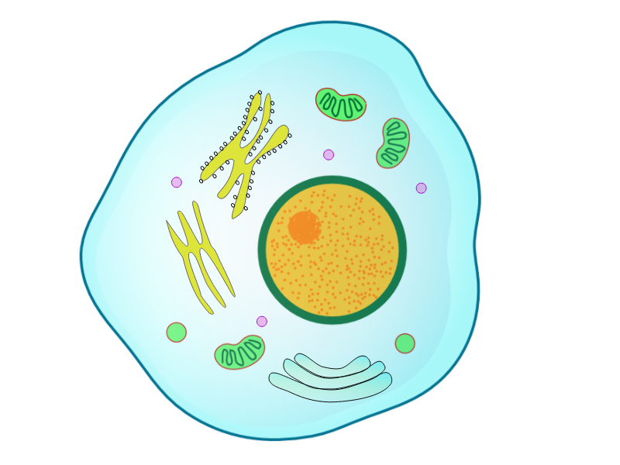




Notes:
Aging is the time-dependent functional decline of an organism at all levels, from nanoscopic to the whole person; it results in vulnerability to perturbation and increased risk of death. This complex process lies at the intersection of genetics, biology, and the environment.

Slide 7
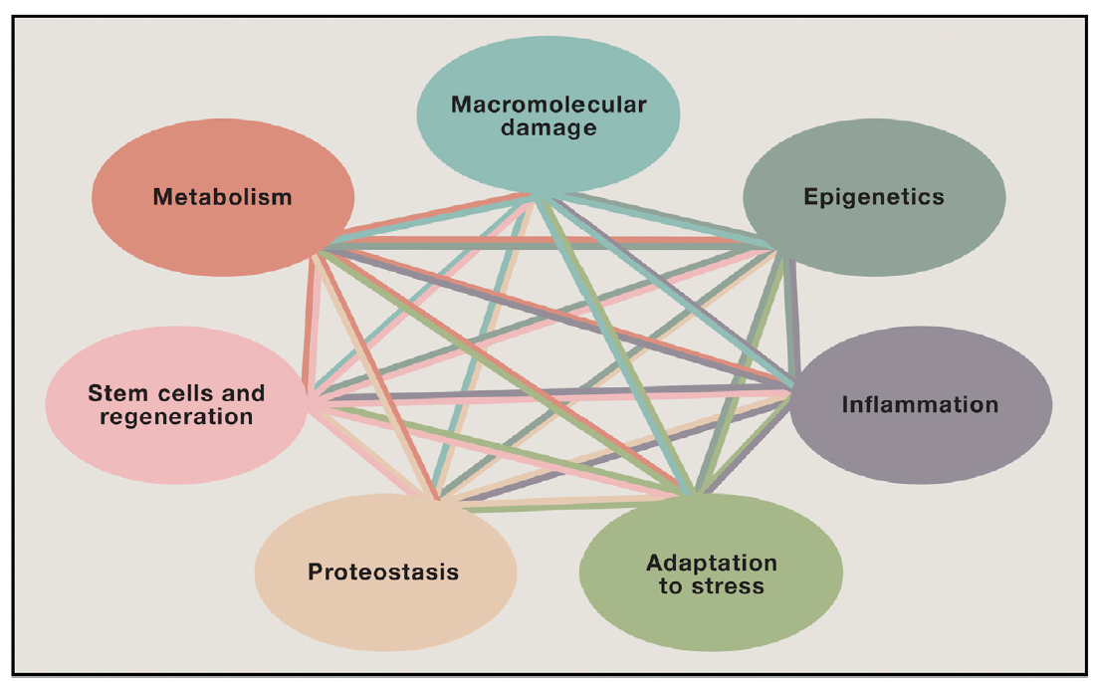
Notes:
There are seven factors, highly inter twined processes that define aging.
Adaptation to stress:
Bridge continuum from psychological to molecular stresses
Differentiate hormesis from toxic stress
Better align human and animal studies
Epigenetics:
Biomarker development: chronologic vs. biologic aging
Link age-related environmental inputs to epigenetic signatures
Test small molecules that regulate enzymes controlling epigenetic events
Inflammation:
Differentiate adaptive and maladaptive inflammatory responses
Define age-related inflammatory sources and their systemic effects
Determine how obesity and metabolic dysfunction alter inflammation with age
Macromolecular damage:
Generate systems-level understanding of the types of macromolecular damage and their roles in chronic disease states
Understand how stochastic damage influences the variability of aging events
Metabolism:
Define role of signal transduction pathways linked to metabolism in the aging process
Understand contribution of circadian clocks to aging and metabolism
Connect metabolic dysfunction with tissue-specific decline in aging

Slide 8
Sarcopenia

Slide 9
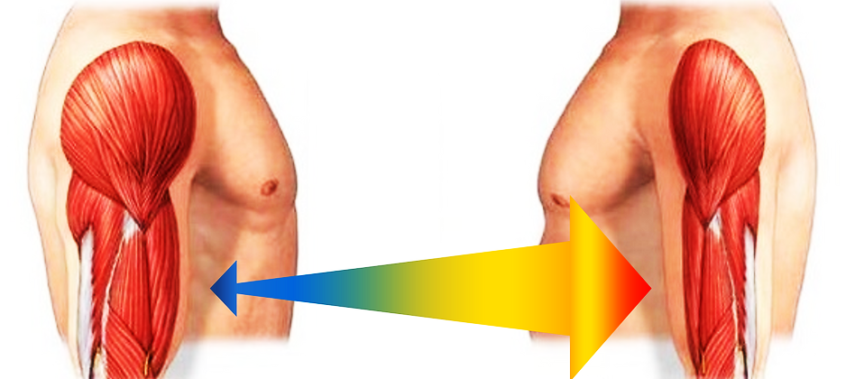
Notes:
One of the most striking effects of age is the involuntary loss of muscle mass, strength, and function, termed sarcopenia.

Slide 10
After 30 years old
Frailty
~3 – 8 %
Loss of muscle mass per decade
Fractures
Reduced quality of life
Notes:
. From the time you are born to around the time you turn 30, your muscles grow larger and stronger. But at some point in your 30s, you start to lose muscle mass and function. No matter the lifestyle, everybody is going to loss between 3 to 8% of muscle mass per decade after age 30, and this rate of decline is even higher after the age of 60. Sarcopenia is associated with detrimental clinical outcomes, such as a reduced quality of life, frailty, an increased risk of falls, fractures, hospitalization, and mortality.

Slide 11
Sarcopenia cause
Chronic inflammation
Increased reactive oxidative species
Increased fibrosis of muscle
Notes:
We mentioned that aging have a lot of factors attached to it, in the specific case of Sarcopenia we can include chronic inflammation, increased reactive oxidative species, and increased fibrosis of muscle, among others have been reported to contribute to development of sarcopenia

Slide 12
Sarcopenia
Muscle atrophy
Notes:
So, bascically…

Slide 13
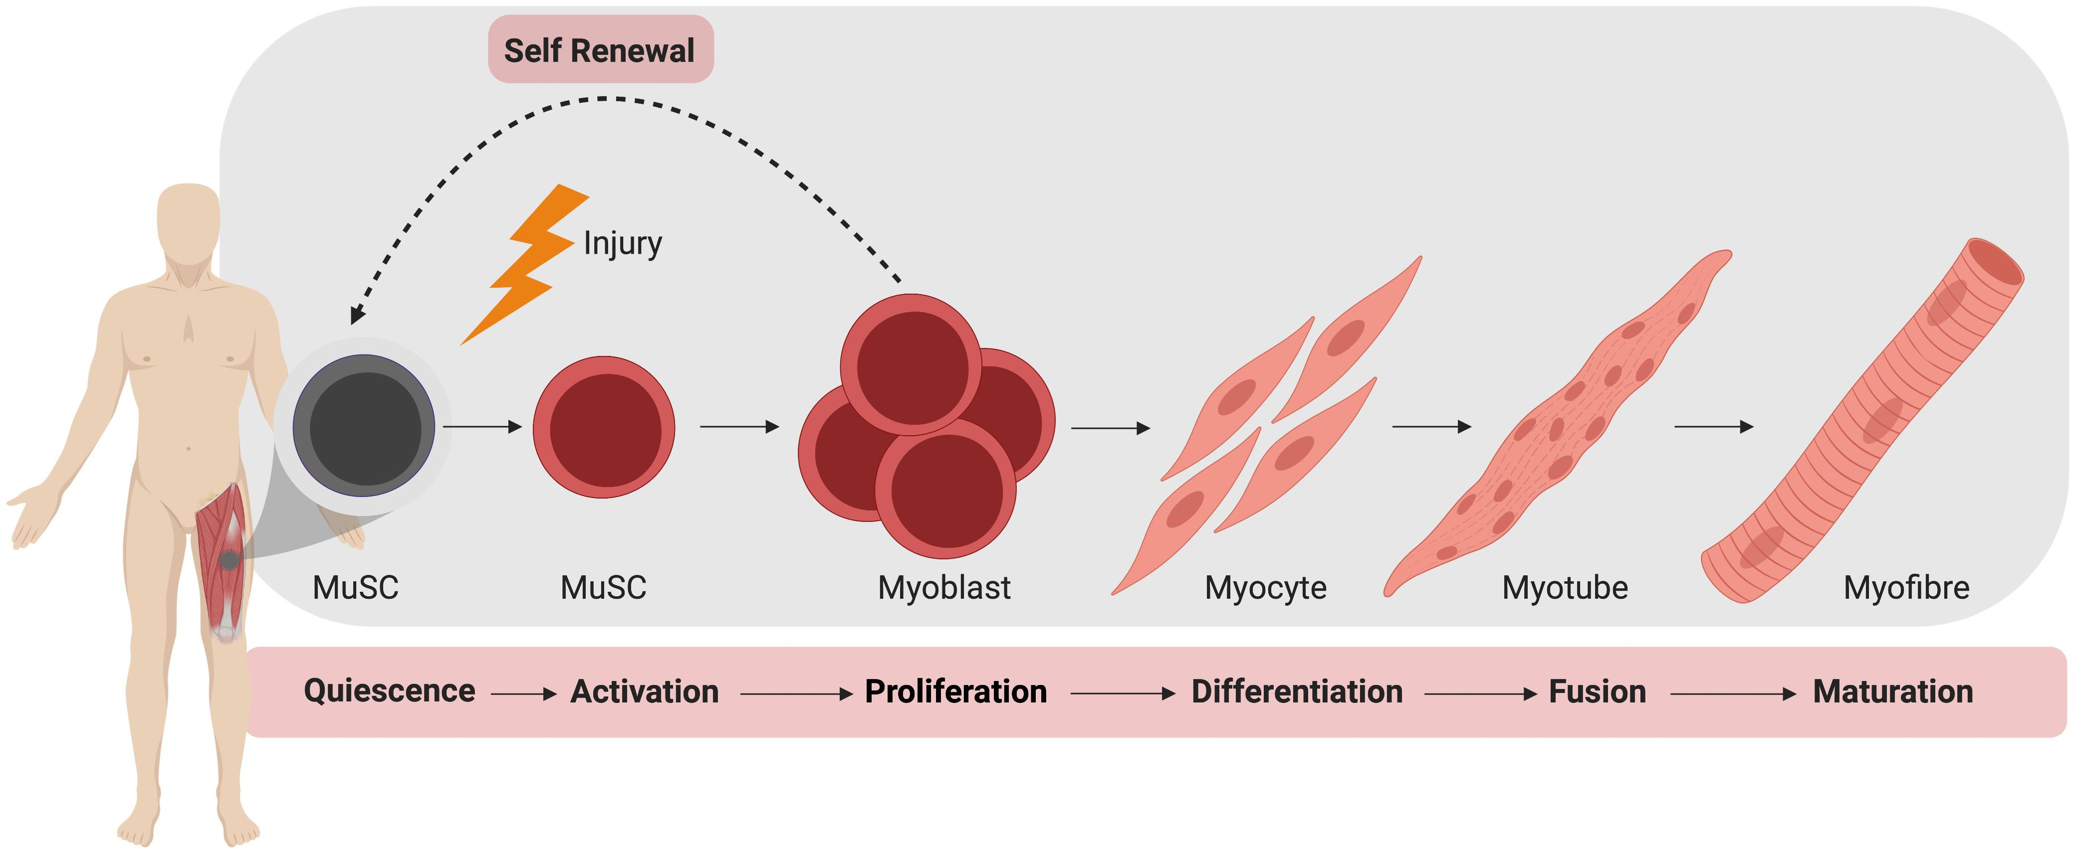
Myogenesis
Notes:
However, we know that the regeneration in adults of the muscle is possible through a process called myogenesis. . The formation of new muscle fibers and repair of injured myofibres requires the differention of myogenic progenitors from satellite cells.

Slide 14
Myogenesis
Notes:
During the quinescence and activation of these cells, different sets of mirNAS are being expressed, suggesting the role of miRNAS in regulaton of saltellite cell homeostasis, and several miRNA have been shown to regulate miogenesis in adulthood

Slide 15
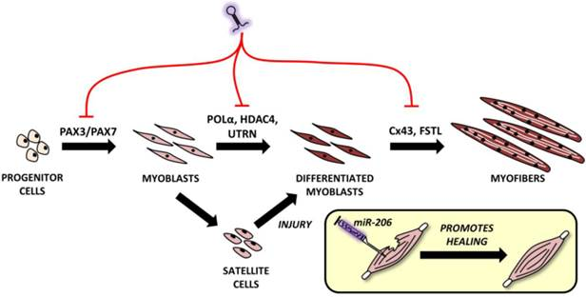
myomirs
Notes:
Muscles express their own set of muscle-enriched mirnas known as myomirs: mir1, 206, 208, 133, 486, 499.

Slide 16
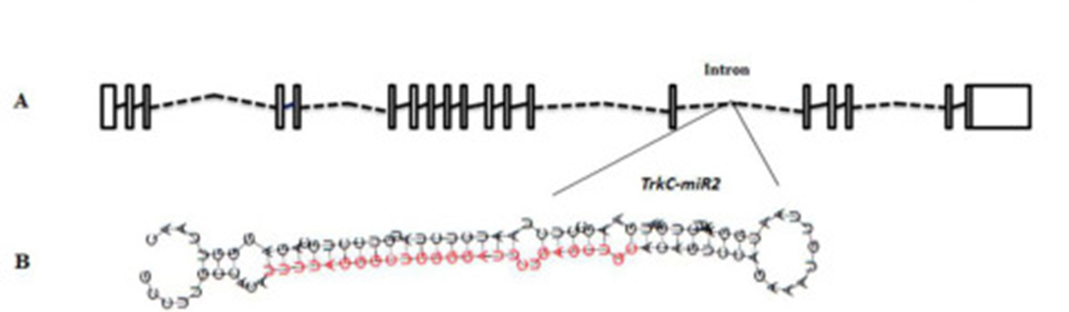
What is a miRNA
18-25 nt single stranded
conserved small non-coding RNAs
regulate almost all cellular functions
cell proliferation
Growth
differentiation
fate and behaviour of stem cells
Notes:
miRNA are defined as 18 to 25 nucleotide single stranded RNAs (ssRNAs), which are produced from hairpin shaped precursors. They are conserved small non-coding RNAs that play an important role in the regulation of gene expression and participate in a variety of biological processes miRNAs have been found to regulate almost all cellular functions including cell proliferation, growth, differentiation and apoptosis, And as we mention, have been implicated in controlling the fate and behavior of stem cells

Slide 17
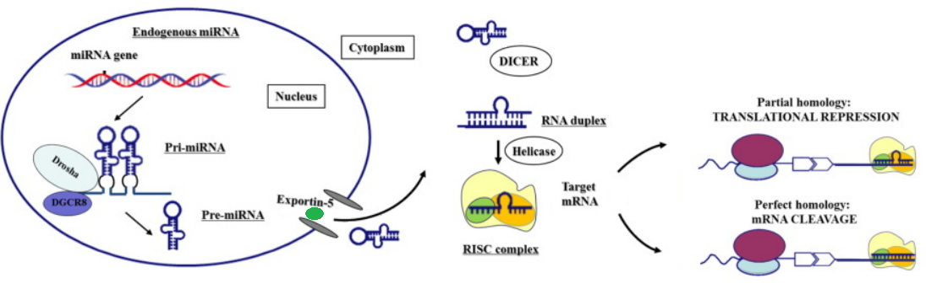
miRNA genesis
Notes:
Modified from https://www.thelancet.com/article/S2352-3964(16)30423-6/fulltext

Slide 18
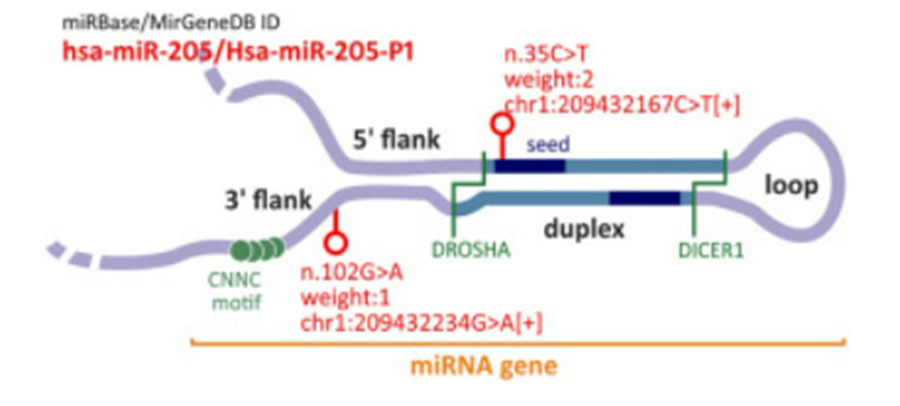
Notes:
https://www.sciencedirect.com/science/article/pii/S2666166721007292

Slide 19
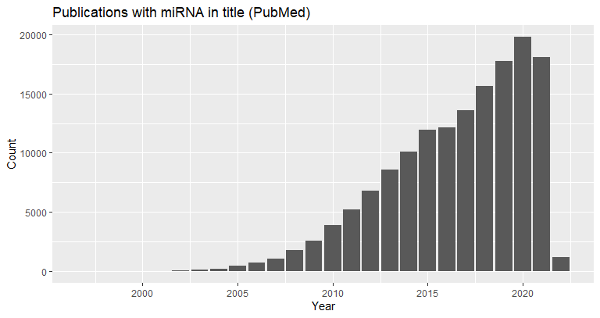
Evolution of miRNA study
miRNAs fall into the class of RNAibased therapeutics
1,120,000 Academic Google
134,677 in PubMed

Slide 20
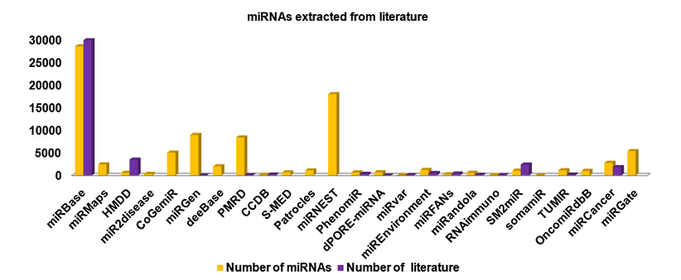
Number of miRNA in some DB

Slide 21
Garbage in, garbage out (GIGO)
Garbage data
Most amazing Data Science project ever
Garbage results

Slide 22
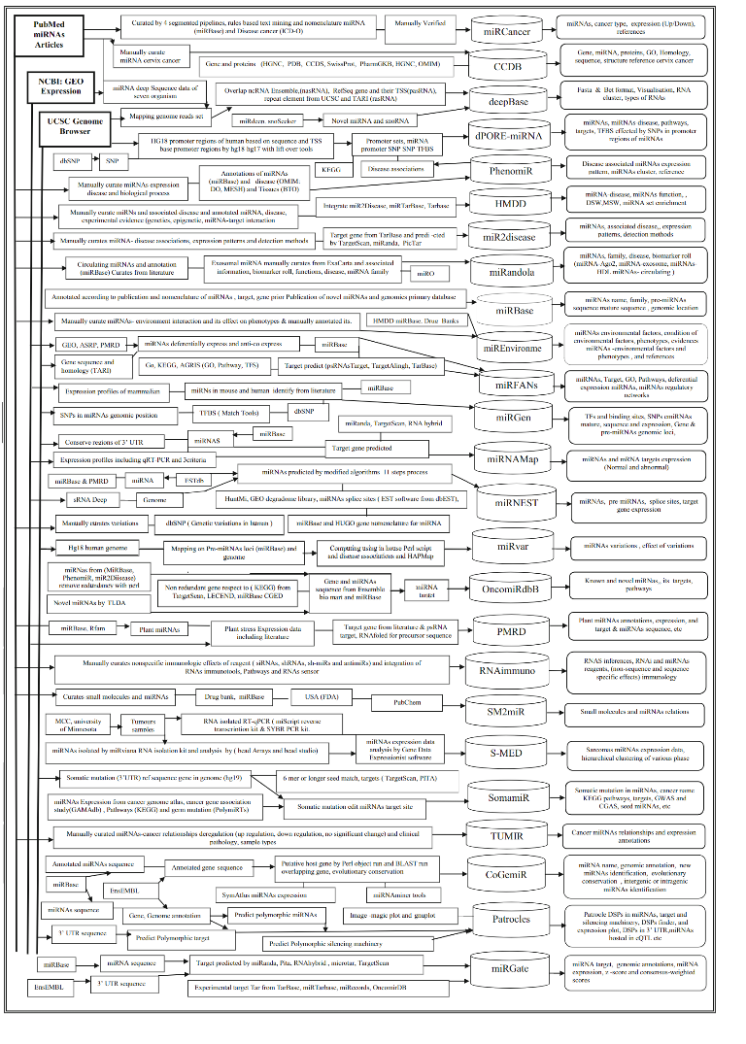

Slide 23
How to select the data?
New
Relevant
Multiple Objective Optimization
PUBMD
Notes:
miRNA are defined as 18 to 25 nucleotide single stranded RNAs (ssRNAs), which are produced from hairpin shaped precursors. They are conserved small non-coding RNAs that play an important role in the regulation of gene expression and participate in a variety of biological processes miRNAs have been found to regulate almost all cellular functions including cell proliferation, growth, differentiation and apoptosis, And as we mention, have been implicated in controlling the fate and behavior of stem cells

Slide 24
How to select the data?
PUBMED
("database"[Title] OR "repository"[Title]
OR "dataset"[Title])
AND
("miRNA"[Title] OR "microRNA"[Title]
OR "micro RNA"[Title])
Notes:
miRNA are defined as 18 to 25 nucleotide single stranded RNAs (ssRNAs), which are produced from hairpin shaped precursors. They are conserved small non-coding RNAs that play an important role in the regulation of gene expression and participate in a variety of biological processes miRNAs have been found to regulate almost all cellular functions including cell proliferation, growth, differentiation and apoptosis, And as we mention, have been implicated in controlling the fate and behavior of stem cells

Slide 25
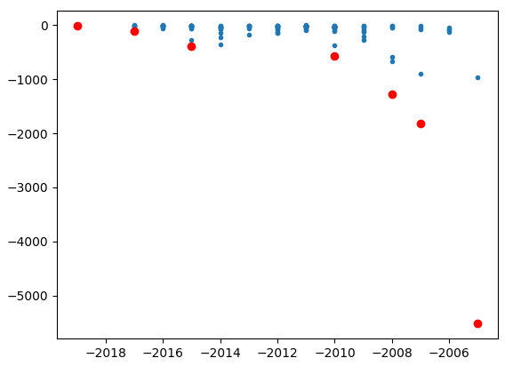
How to select the data?
Notes:
miRNA are defined as 18 to 25 nucleotide single stranded RNAs (ssRNAs), which are produced from hairpin shaped precursors. They are conserved small non-coding RNAs that play an important role in the regulation of gene expression and participate in a variety of biological processes miRNAs have been found to regulate almost all cellular functions including cell proliferation, growth, differentiation and apoptosis, And as we mention, have been implicated in controlling the fate and behavior of stem cells

Slide 26
How to select the data?
Database | year | Cites | PubmedID | Content
miRBase | 2014 | 2368 | 24275495 | General
miRWalk | 2011 | 830 | 21605702 | Predicted miRNA
miRTarBase | 2010 | 563 | 21071411 | General
miRDB | 2020 | 374 | 31504780 | Expression
Rfam | 2021 | 49 | 33211869 | Family
miRNASNP | 2021 | 13 | 32990748 | Single nuclotide
mirtronDB | 2019 | 5 | 30874795 | mirtrons
DIANAmiTED | 2022 | 0 | 34469540 | Expression
Notes:
miRNA are defined as 18 to 25 nucleotide single stranded RNAs (ssRNAs), which are produced from hairpin shaped precursors. They are conserved small non-coding RNAs that play an important role in the regulation of gene expression and participate in a variety of biological processes miRNAs have been found to regulate almost all cellular functions including cell proliferation, growth, differentiation and apoptosis, And as we mention, have been implicated in controlling the fate and behavior of stem cells

Slide 27

First publication 2002 (then called the microRNA Registry)
Names and distributes microRNA gene sequences.
Author submission
Current release v22
Notes:
miRNA are defined as 18 to 25 nucleotide single stranded RNAs (ssRNAs), which are produced from hairpin shaped precursors. They are conserved small non-coding RNAs that play an important role in the regulation of gene expression and participate in a variety of biological processes miRNAs have been found to regulate almost all cellular functions including cell proliferation, growth, differentiation and apoptosis, And as we mention, have been implicated in controlling the fate and behavior of stem cells

Slide 28





Characterization
Target mRNA
Expression Tissue
HMDD v3.2

Slide 29


miRBase local database in mySQL
www.mirbase.org/ftp/CURRENT/database_files/

Slide 30
Process for python processing of data
General objective: Get all datasets together for evaluation
Recompile all the datasets
Distinguish the differences and similarities
Design the model with compatibility for all datasets
Separate the txt datasets in order to run a LOAD DATA LOCAL INFILE

Slide 31



Gene names
Entrez Programming Utilities
E-Utilities

Slide 32
miRNA : Gene binding
Targets: 29,951
miRNAs: 5,277
Combinations miRNAs-Target: 8,800,625
Total binding registers: 15,436,301
mirWalk 15,428,606
hsa 12,526,887
mmu 2,018,527
dre 890,399

Slide 33
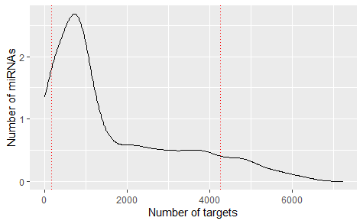
Number of target from a single miRNA
163 One target
2761 Few targets (<1000)
638 Many targets (>4000)
Total: 5277

Slide 35
Acknowledgements
This presentation has emanated from research conducted with the financial support of Science Foundation Ireland under Grant number [18/CRT/6214 ]

Slide 37
Read and get familiarize with:
TargetScan
miRNet
Enrichr
Cytoscape
PathVisio
Ingenuity Pathway Analysis
Complex Pathway Simulator
GENE Expression Omnibus
Xpress

Slide 38
Thank You

Slide 39
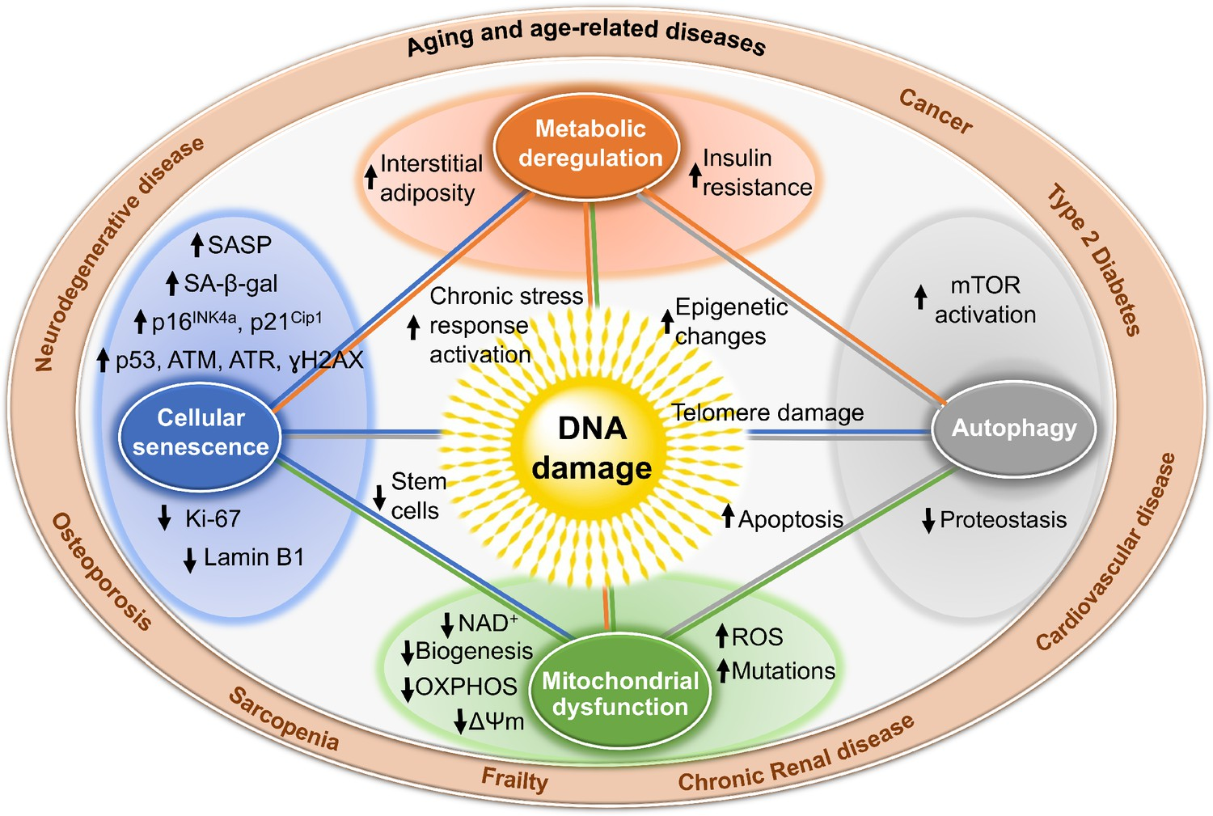
Why miRNAS
Notes:
Well, Aging is the cause of Sarcopenia, but this involves plenty of different processes that make it complicated to approach by isolating one pathway or one gene. And using small molecules work as a preventive method, they don’t regenerate the muscle. , microRNA allows a cleaner approach, because we can know the target and escalate to more parts of the body.

Slide 40
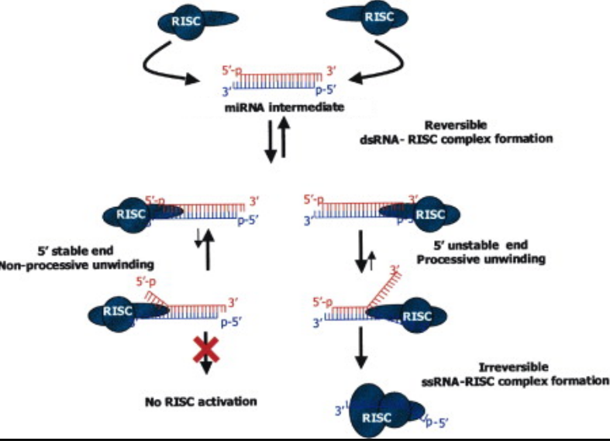
miRNA duplex
Notes:
Edited from https://www.cell.com/fulltext/S0092-8674(03)00801-8

